Slide 1
There two graph data file
Data graph ( human )
Query graphs ( human_40 )
( include 100 graphs )

Slide 2
Data graph ( human )
The smallest number of vertex is 0.
At first line, “t [graph id] [the number of vertices : v]
in human, graph id is always 1. ( There is only one graph in file )
From second line to v+1 line,
“v [vertex id] [label of node]” is given.
in the rest of lines,
“e [vertex 1] [vertex 2] [label of edge]
but label of edge is not important in this project.

Slide 3
t 1 4
v 0 1
v 1 0
v 2 0
v 3 1
e 0 1 0
e 0 2 0
e 1 3 1
e 1 2 1
e 2 3 0
0
1
1
0
0
0
1
1
2
0
3
1
0

Slide 4
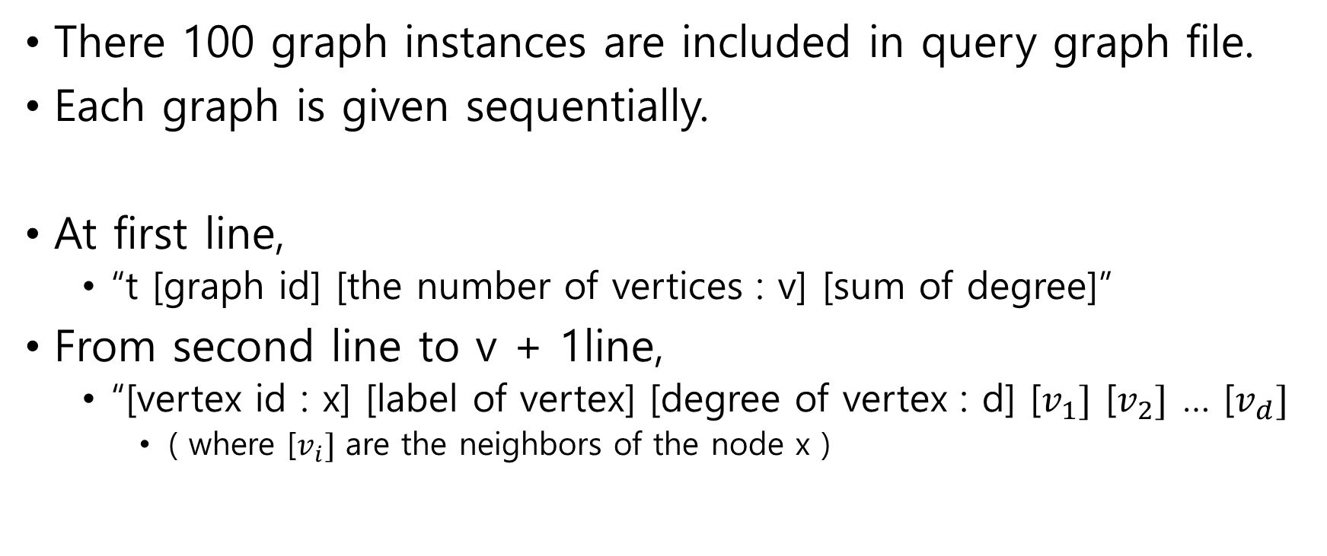
Query graphs ( human_40n )
There 100 graph instances are included in query graph file.
Each graph is given sequentially.
At first line,
“t [graph id] [the number of vertices : v] [sum of degree]”
From second line to v + 1line,
“[vertex id : x] [label of vertex] [degree of vertex : d] [$v_{1}]$ [$v_{2}]$ … [$v_{d}]$
( where [$v_{i}]$ are the neighbors of the node x )

Slide 5
0
1
1
0
t 0 4 10
0 1 2 1 2
1 0 3 0 2 3
2 0 3 0 1 3
3 1 2 1 2
2
0
3
1

Slide 6
Dag output format
For each graph instance, permutation of vertices should be given in one line.

Slide 7
query graph
0
1
1
0
2
0
3
1
3
1
0
1
1
0
2
0
permutation output for query graph : 3 0 1 2

